Slide 1

Introduction to Python Programming
Week 1

Slide 2
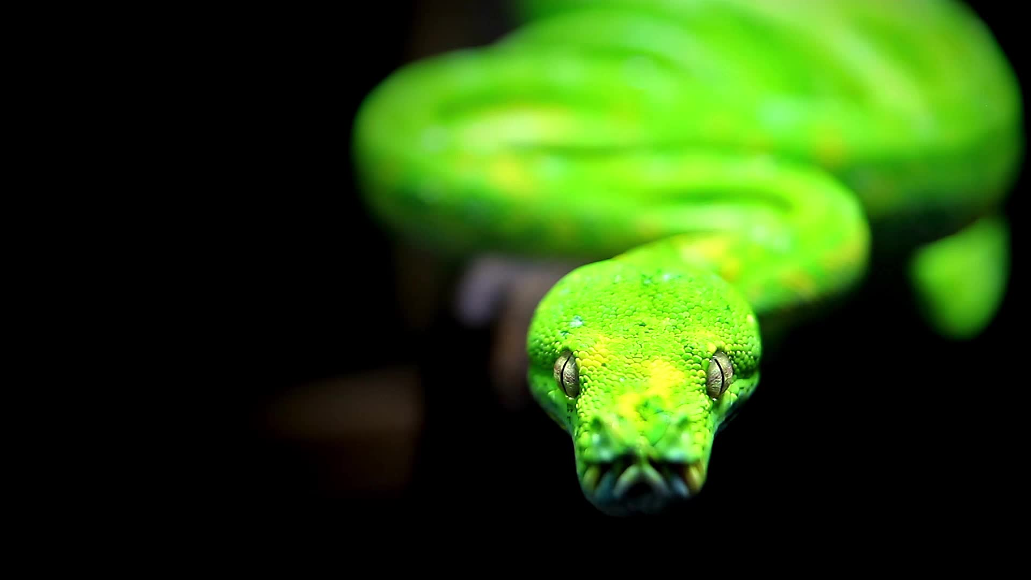
Background
Python is a high-level, interpreted programming language that is widely used for web development, data analysis, artificial intelligence, and scientific computing. It is a versatile language that is easy to learn and can be used for a wide range of tasks.

Slide 3
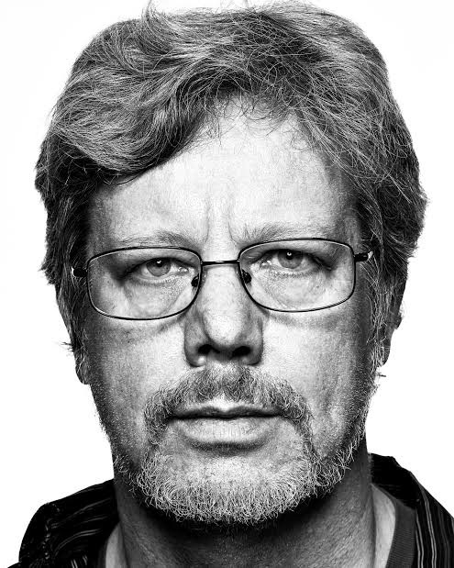
Guido Van Rossum
Guido van Rossum is a Dutch programmer and the creator of the Python programming language. He started working on Python in 1989, and the first version was released in 1991. He continued to work on the language throughout the 1990s and until the early 2000s, when he stepped down as the "Benevolent Dictator for Life" (BDFL) of the Python community. He is also known for his contributions to the open-source community.
Python, which is named after the Monty Python comedy group, is widely used in many fields such as web development, scientific computing, data analysis, artificial intelligence and more.
It is known for its simplicity, readability and easy to learn. Python is also often used as a first-language to teach programming.

Slide 4
Standard Python Road MAP
Basic Syntax
Variables
Data types (Strings, Numbers, List, Tuples, Sets, Bool)
Control Flow (Conditions, Loops)
Functions (Generators, iterators built-in, lambda)
OOP (Classes, Objects, Inheritance, Abstraction)
Decorators
Exceptions
Testing
Modules

Slide 5
Applications of Python
Web development: Python has a number of popular web frameworks such as Flask and Django that make it easy to build web applications. It can also be used to write scripts to automate web scraping and data extraction.
Scientific computing and data analysis: Python has a number of powerful libraries for data analysis and visualization, such as NumPy, pandas, and Matplotlib. These libraries make it easy to work with large sets of data and perform complex calculations.
Machine learning and artificial intelligence: Python has become a popular choice for developing machine learning and AI models, thanks to libraries such as scikit-learn, TensorFlow, and Keras.
Automation and scripting: Python is often used for automating repetitive tasks and writing scripts to automate workflows. It can be used to control and automate software, such as Blender, GIMP, and Autodesk Maya, and even hardware like Raspberry Pi, Arduino.
Game development: Python is also used to develop games using libraries like Pygame and PyOpenGL.
Networking: Python has a number of libraries for working with network protocols, such as Scapy and Twisted.

Slide 6
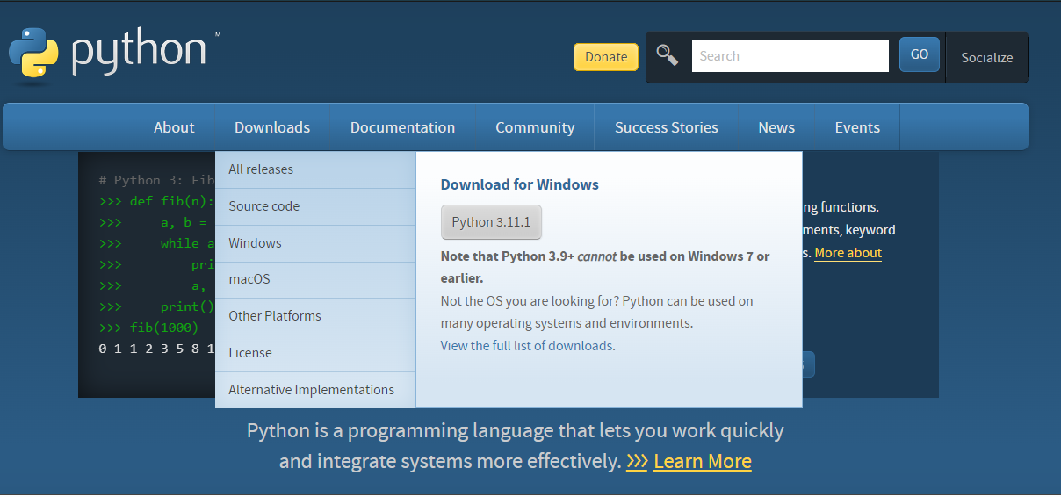
DOWNLOADING PYTHON
Open a browser to the Python website and download the Windows installer.
https://www.python.org/
DOWNLOAD THE LATEST OR THE LONG TERM SUPPORT (LTS) VERSION

Slide 7
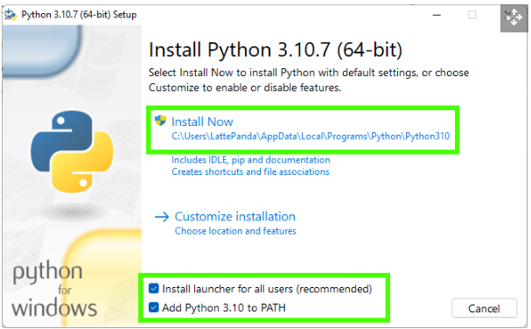
INSTALLING PYTHON
Double click on the downloaded file and install Python for all users, and ensure that Python is added to your path. Click on Install now to begin. Adding Python to the path will enable us to use the Python interpreter from any part of the filesystem.
DON’T MIND THE VERSION. ALWAYS GET THE LATEST OR THE LTS.

Slide 8
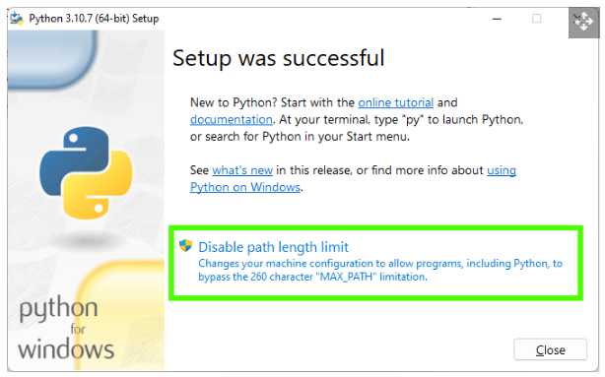
ADDING PYTHON TO PATH
After the installation is complete, click Disable path length limit and then Close. Disabling the path length limit means we can use more than 260 characters in a file path.

Slide 9
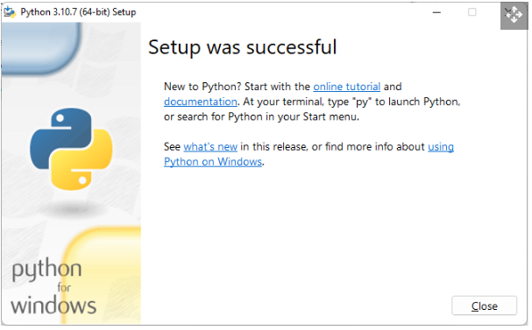
FINISHING
Click Close to end the installation.

Slide 10
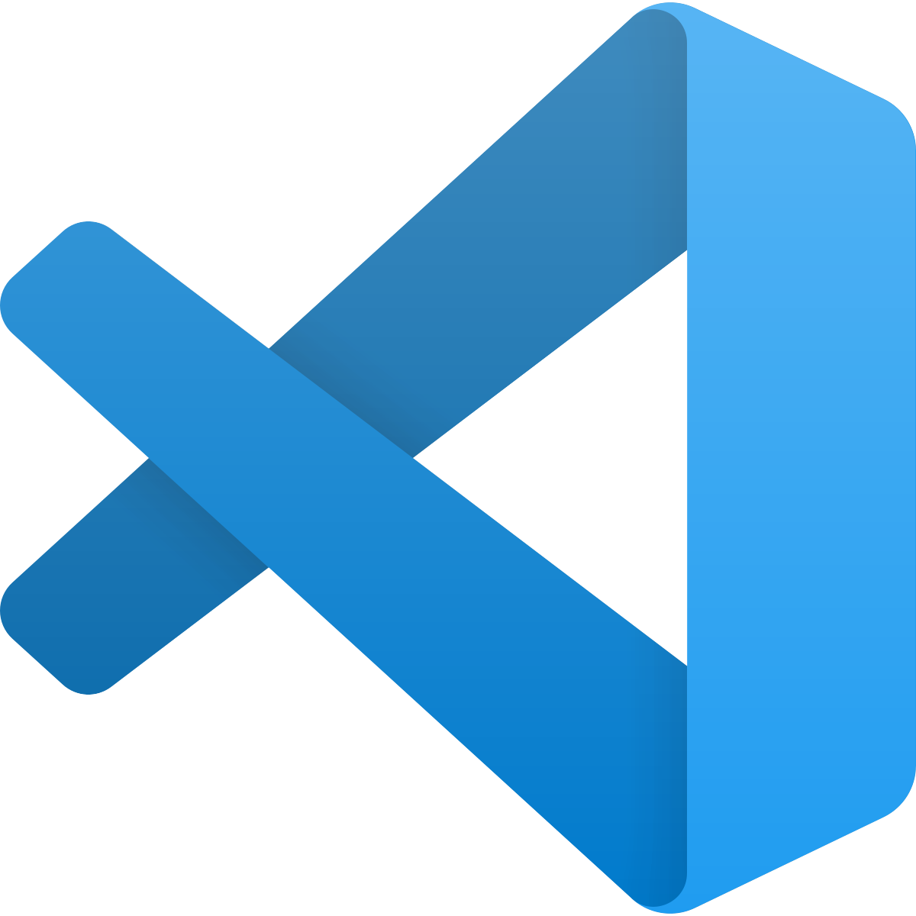


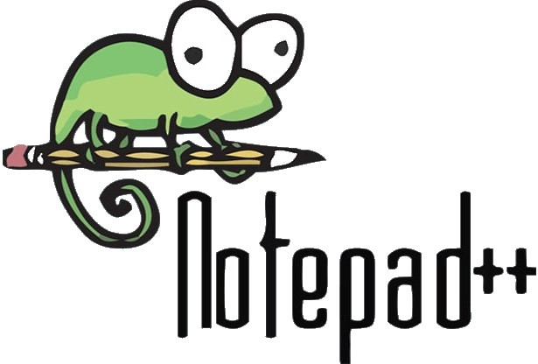
CODE EDITORS
PyCharm
VSCode
Sublime Text
Notepad++

Slide 11
Python Virtual Environment
A virtual environment, or virtualenv, is a tool used to isolate specific Python environments on a single machine, allowing for separate dependencies, packages, and Python versions for different projects.
When you create a virtualenv, it creates a separate copy of Python and any packages you install in that environment. This allows you to work on multiple projects on the same machine without them interfering with each other. For example, you might have one project that requires Python 3.6 and another that requires Python 3.8, or one project that uses a specific version of a package while another project uses a different version. Virtual environments make it easy to switch between these different environments without having to constantly re-install packages or change your global Python version.
Additionally, using virtual environment can also make it easier to share your code with others, as you can specify the exact versions of the packages your code depends on in a virtual environment. This helps to avoid any compatibility issues with different versions of packages.

Slide 12
Creating a Python Virtual Env
To create a virtual environment in Windows using Python 3, you can use the built-in venv module. Here are the steps:
Open the command prompt or PowerShell.
Navigate to the directory where you want to create the virtual environment.
Run the command python -m venv env to create a virtual environment named "env". You can replace "env" with the name of your choice.
Activate the virtual environment by running the command env\Scripts\activate. The command prompt should now be prefixed with the name of the virtual environment.
You can now install packages and use them in this virtual environment without affecting other Python installations or environments on your system.
To deactivate the virtual environment, you can use the command deactivate.
You can also use other tools like virtualenv or pipenv to create virtual environments in windows.

Slide 13
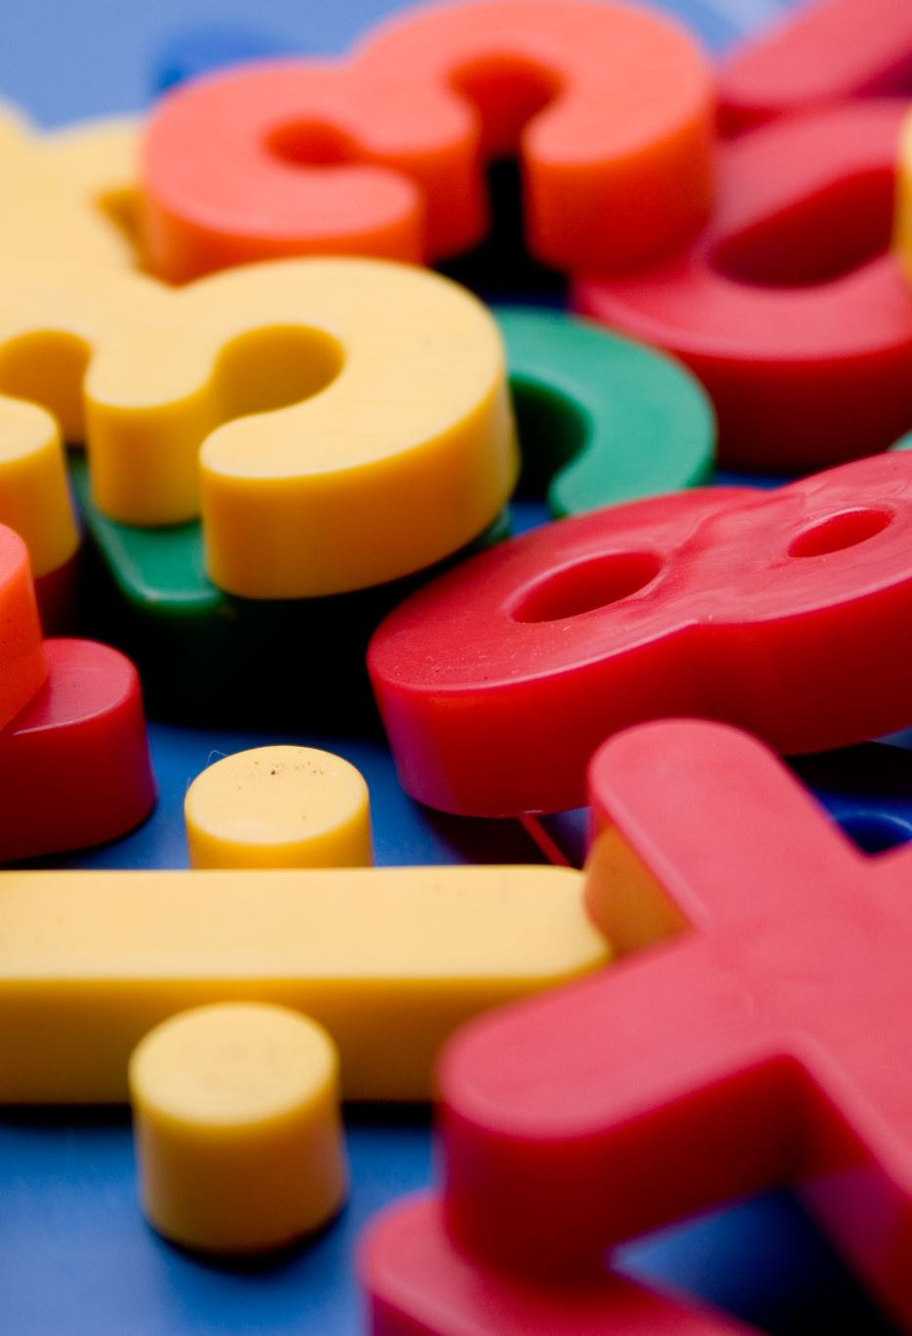
Variables
Used to store values in a program. In Python, you can use any name as a variable name, but it should not start with a number or special characters. For example:
x = 5
y = "Hello, World!"

Slide 14
Data Types
Python supports various data types such as integers, floating-point numbers, strings, and Boolean values. For example:
x = 5 # integer
y = 3.14 # float
z = "Hello, World!" # string
b = True # Boolean

Slide 15
Operators
Python supports various operators such as arithmetic, comparison, and logical operators. For example:
x = 5
y = 3
# Arithmetic operators
print(x + y) # 8
print(x - y) # 2
print(x * y) # 15
print(x / y) # 1.6666666
# Comparison operators
print(x == y) # False
print(x > y) # True
# Logical operators
print(x > 3 and x < 10) # True

Slide 16
Conditional Statements
Used to control the flow of a program based on certain conditions. Python supports if, elif, and else statements. For example:
x = 5
if x > 0:
print("x is positive")
elif x < 0:
print("x is negative")
else:
print("x is zero")

Slide 17
Loops
Used to execute a block of code multiple times. Python supports for and while loops. For example:
# For loop
for i in range(5):
print(i)
# while loop
i = 0
while i < 5:
print(i)
i += 1

Slide 18
Functions
Used to group a set of related code together and can be reused throughout the program. Python supports the use of functions with the 'def' keyword. For example:
def add(x, y):
return x + y
print(add(5, 3)) # 8

Slide 19
Lists and Tuples
These are both built-in data types that allow you to store multiple values in a single variable. Lists are enclosed in square brackets [] and are mutable, meaning you can add, remove or change values within the list. Tuples are enclosed in parentheses () and are immutable, meaning you can't change the values once they are assigned. For example:
# Lists
fruits = ["apple", "banana", "orange"]
print(fruits) # ["apple", "banana", "orange"]
fruits.append("mango")
print(fruits) # ["apple", "banana", "orange", "mango"]
# Tuples
numbers = (1, 2, 3)
print(numbers) # (1, 2, 3)
# numbers[1] = 4 # This will raise a TypeError, because tuples are immutable

Slide 20
Dictionaries
Like lists and tuples, but instead of using indexing to access the values, you use keys. Dictionaries are enclosed in curly braces {} and keys are unique within the dictionary. For example:
person = {"name": "John", "age": 30, "gender": "male"}
print(person["name"]) # "John"
print(person["age"]) # 30
person["age"] = 31
print(person["age"]) # 31

Slide 21
Modules and Libraries
Python has many built-in modules and libraries that provide additional functionality. For example, the math module provides mathematical functions, while the `os` module provides functions for interacting with the operating system. You can also install third-party libraries using package managers like pip. For example:
import math
print(math.pi) # 3.141592653589793
import os
print(os.getcwd()) # prints the current working directory

Slide 22
Exception Handling
Exception handling is a way to handle errors that occur during the execution of a program. Python uses try-except blocks to handle exceptions. For example:
try:
x = 5 / 0
except ZeroDivisionError:
print("Cannot divide by zero.")

Slide 23
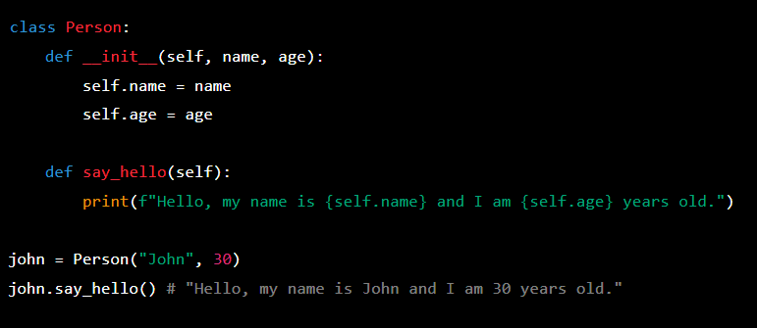
Object-Oriented Programming (OOP)
Python supports OOP, which is a programming paradigm that focuses on creating objects, which have methods and properties, and are instances of classes. This allows for code reuse and organization. For example:

Slide 24
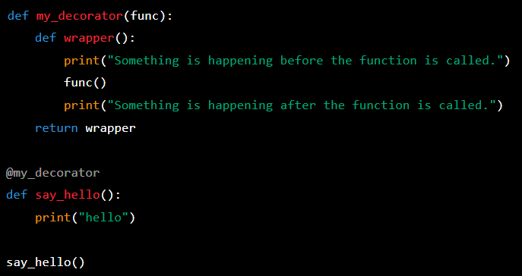
Decorators
Decorators are a way to add functionality to existing functions without modifying the original code. They are defined using the @ symbol followed by the name of the function that will be used as a decorator. They can be used to add logging, timing, or other types of functionality to functions. For example:

Slide 25
Context Managers
An object that defines the methods __enter__() and __exit__() that are used to set up and tear down resources.
The most common use of context managers is to handle file I/O. For example:
with open("example.txt", "w") as file:
file.write("Hello World!")

Slide 26

Closing
These are some of the fundamentals of Python programming. Of course, there are more advanced features and libraries available in Python, but understanding these basics will provide a solid foundation for further learning.

